Slide 1
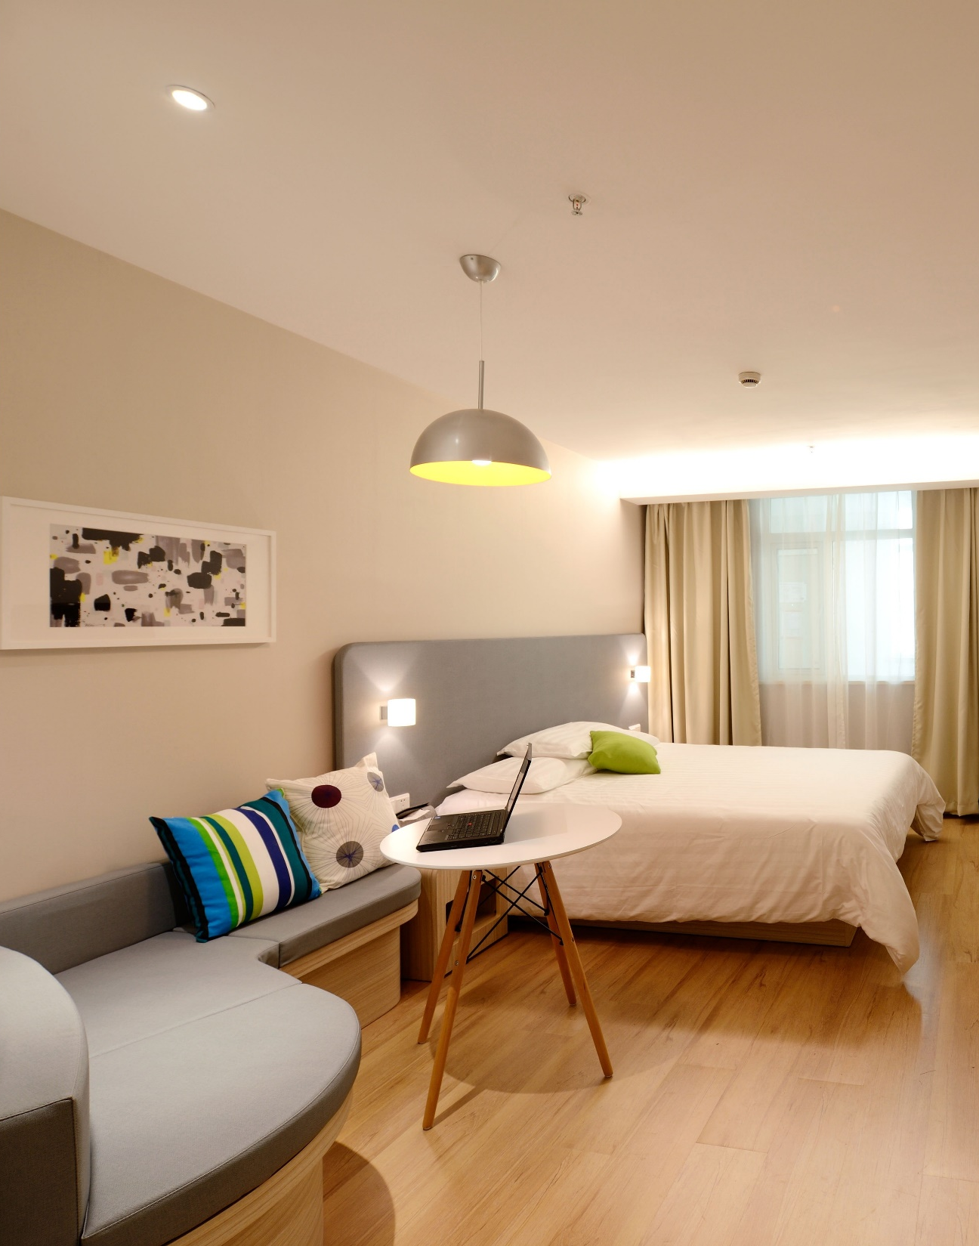

Listings in Singapore
By: Cicilia Parastita Ningrum

Slide 2


MILESTONE 2

Slide 3
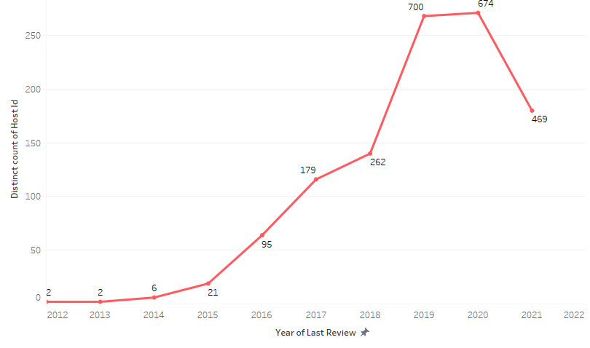
Number of hosts per neighborhood

Slide 4
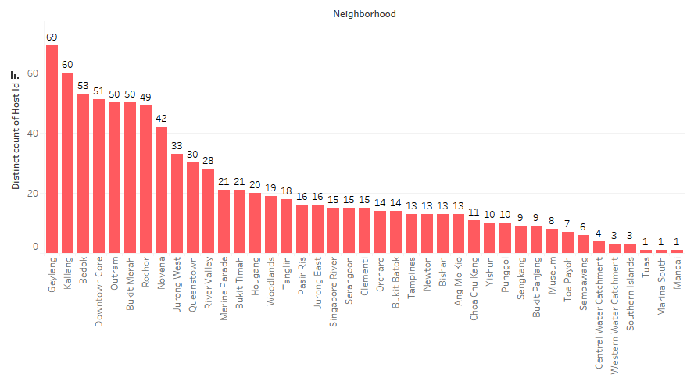
Number of hosts

Slide 5
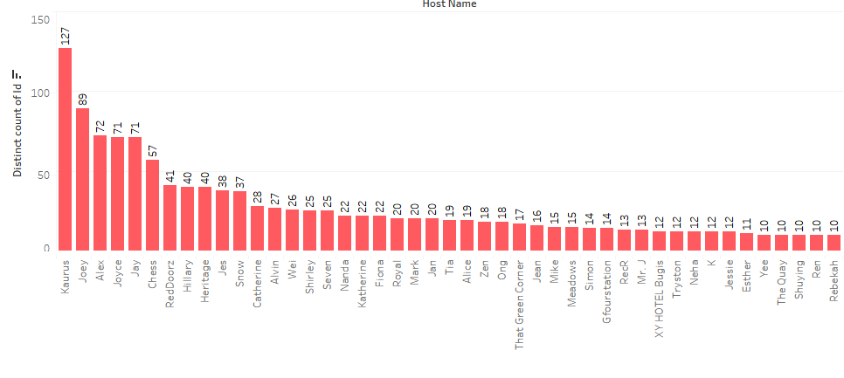
Number of listings per host

Slide 6
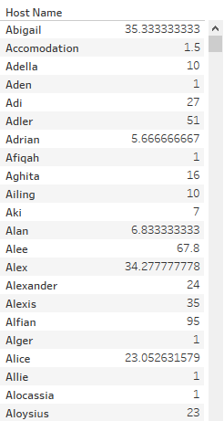
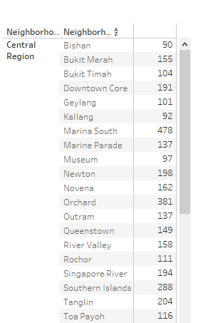
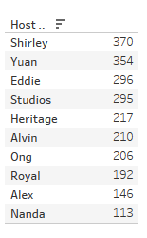
Average number of reviews per host
Average price per neighborhood group and neighborhood
Top 10 hosts based on highest review

Slide 7
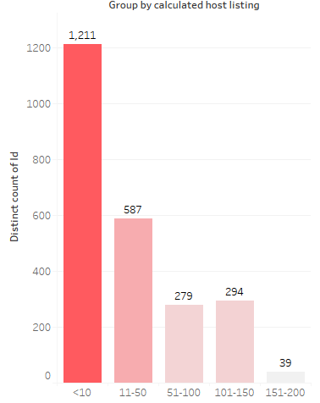
Number of listings per group

Slide 8
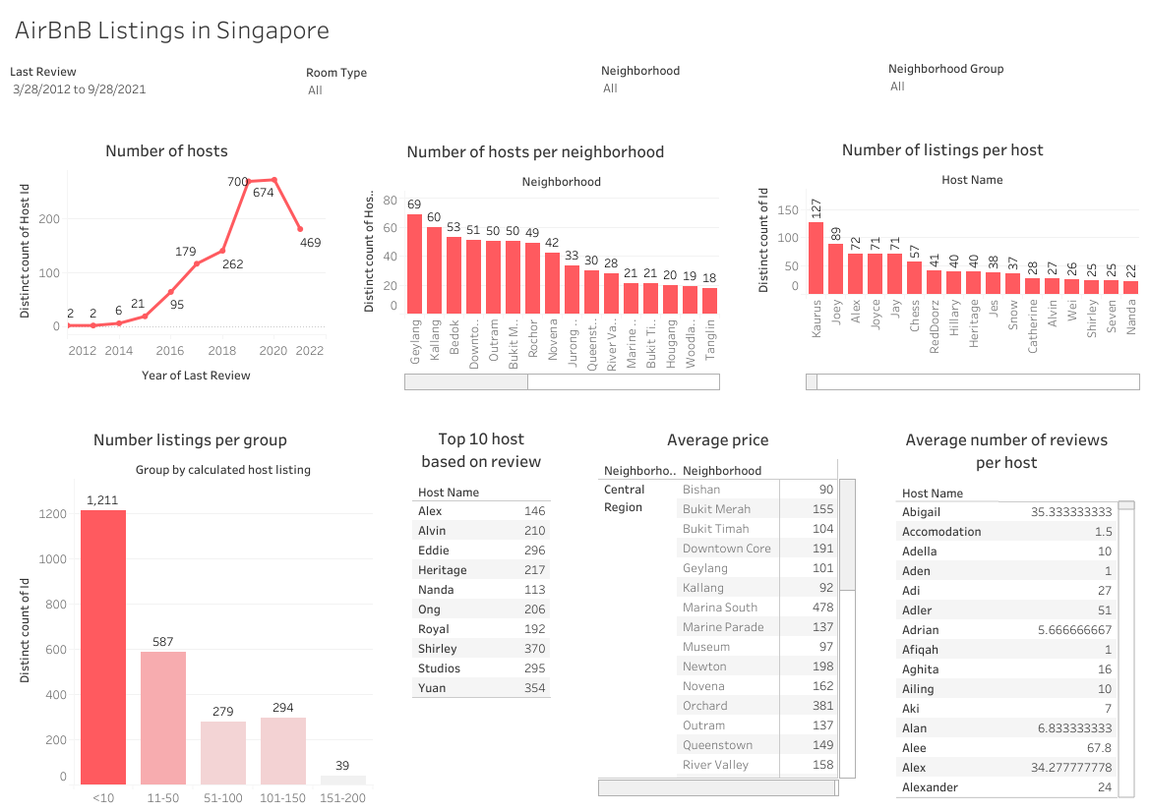
Link: https://bit.ly/ListingsinSingapore

